Slide 1

Student Presentations
By: Nasim, Aldo, Xavier, Ian, Sam, Eura, Mengyuan
College of Computing and Digital Media
DePaul University

Slide 2

What we are going to talk about?
Fairness-Aware Recommendation Systems by Nasim
Librec Auto & CCOL RS by Aldo and Xavier
C. Elegans Movement Behavior Analysis by Yiyang (Ian)
Towards suicide risk and stage assessment by Rae & Mengyuan
MEDIX: Medical Informatics Experience by Sam and Eura

Slide 3


Slide 4
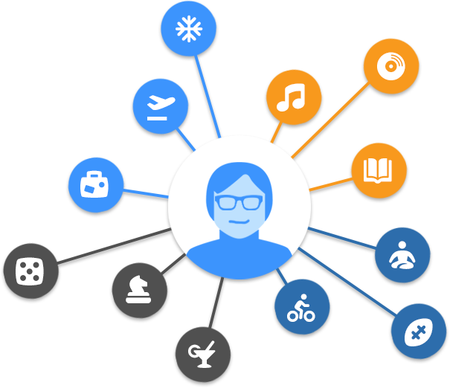

Fairness-Aware Recommendation Systems
Presenter: Nasim Sonboli
Advisor: Dr. Robin Burke
Co-advisor: Bamshad Mobasher
Collaborator: Aldo Ordonez

Slide 5


Recommender Systems
Help in dealing with information overload by filtering irrelevant information.
Help users find the information they are interested in considering their past behavior.
Ratings
Musics they listened to
Movies they watched

Slide 6

Recommender System

Slide 7
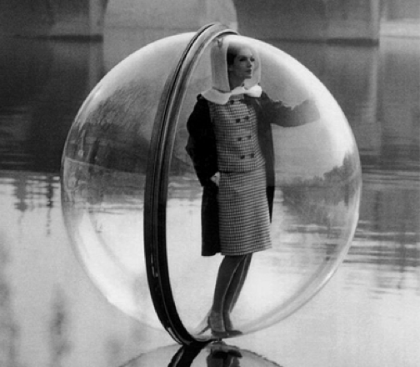
Fairness-Aware Recommendations
Bias can creep into the data
Intentionally or unintentionally
As a result algorithms become biased (bias in -> bias out)
The goal is to remove harmful algorithmic biases -> improve fairness

Slide 8


Fairness-Aware Recommendations
Fairness in access to capital
Loan requests of lower amount get funded faster than high amount requests
Lenders more likely to lend to borrowers in familiar countries or regions of the world

Slide 9

Fairness-Aware Recommendations
Using machine learning methods & recommendation algorithms
We increased fairness by improving the probability of the borrowers in all regions of the world being seen by (recommended to) lenders in kiva dataset.
Data Science can be combined with social sciences to solve real world problems!
You have the flexibility of working in any field!

Slide 10


Librec Auto
Xavier Sepulveda, Aldo Ordonez-Gauger
Research Assistants for DePaul’s Center for Web Intelligence
Undergraduates studying Computer Science

Slide 11
What are LibRec and LibRec Auto?
LibRec is a GPL-licensed Java library aiming to solve two classic tasks in recommender systems, i.e., rating prediction and item ranking which has implemented a wide array of state-of-the-art recommendation algorithms.
LibRec Auto is a supplemental python framework which manages a pseudo-cache of components for previous experiments, introduces additional functionality, and makes interacting with LibRec simpler.

Slide 12
Why are we pursuing LibRec Auto?
LibRec Auto has the propensity to decrease total time when conducting and evaluating multiple recommender experiments.
LibRec Auto has the potential to broadens the users of LibRec by inviting those who do not know what python/java are, but wish to use LibRec.
We, the undergraduate researchers, have learned a great deal about different machine learning life cycles and what Data Science looks like in application (beyond the classroom.)

Slide 13

What is CCOL?
•Chicago City of Learning is a website designed for students (up to high school) to explore and interact with in order to further their learning and interests.
https://chicagocityoflearning.org/

Slide 14

What is CCOL?
•We’ve created a new recommender system which matches student users with online lessons and activities based on previous badges they’ve attained.
• Working on the CCOL site not other furthered others opportunities for education but also exposed us to working on real world large data analytics projects as a team.

Slide 15
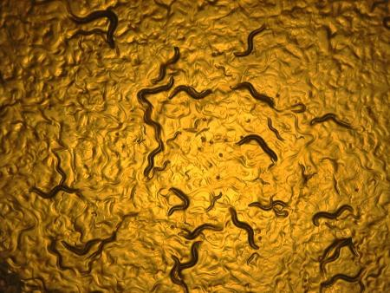
C. Elegans Movement Behavior Analysis
Presenter: Yiyang (Ian) Wang
Student Members: Mingfei Shao, Jennifer Piane, Priya Deshpande, Jie Bao
Faculty Members: Dr. Daniela Raicu, Dr. Jacob Furst, Dr. Hongkyun Kim

Slide 16
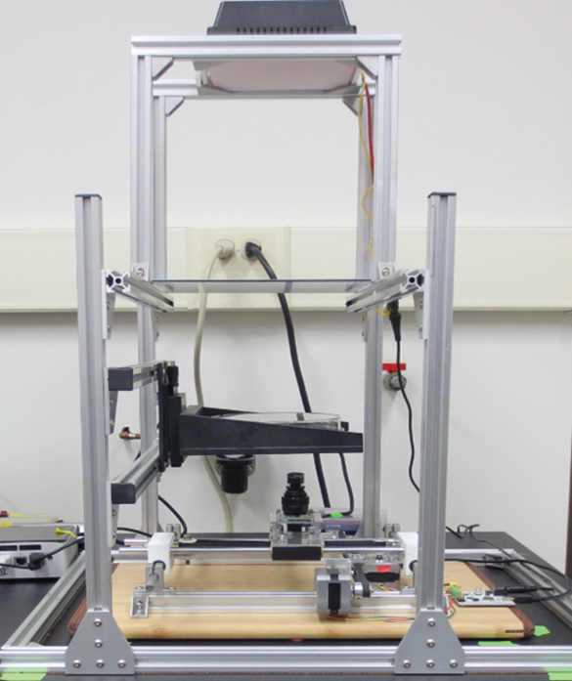
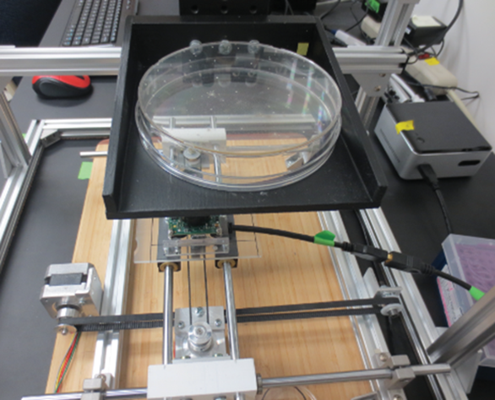
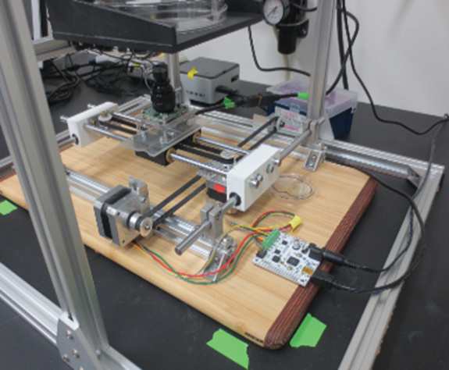
Worm Tracker Device
Moy et al. (2015) PLoS One, vol.10 no.2
Moy et al. (2015) PLoS One, vol.10 no.2
16

Slide 17

C. elegans, Wild-Type, No Food

Slide 18
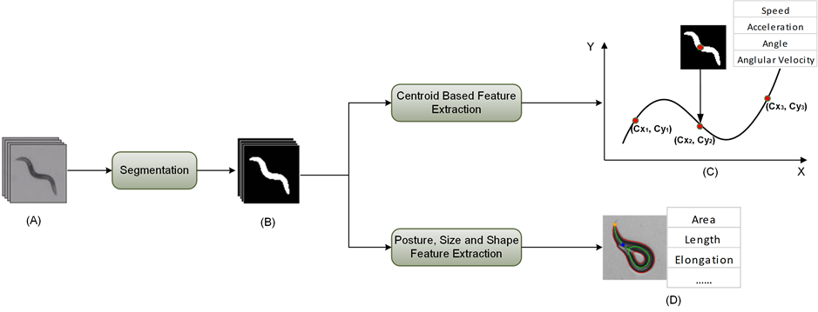
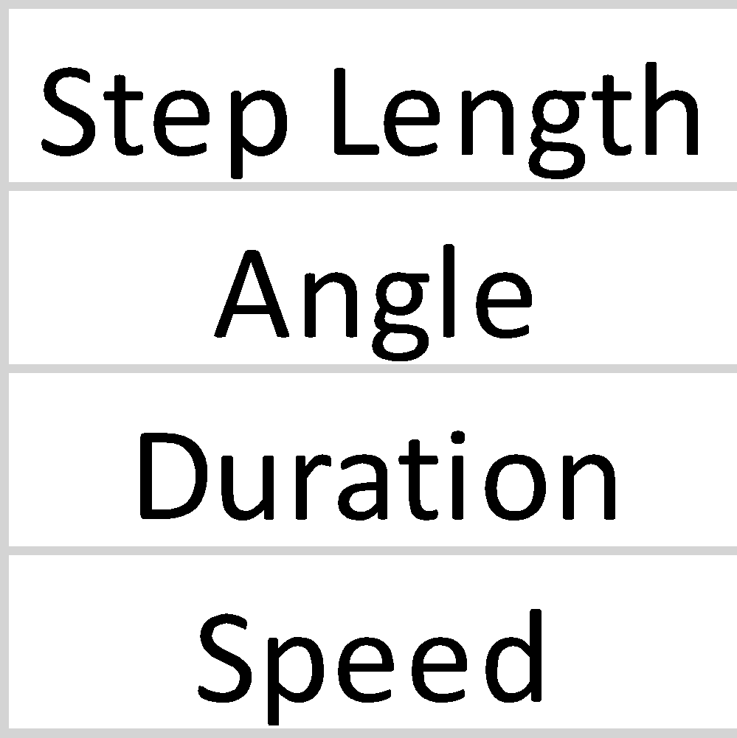
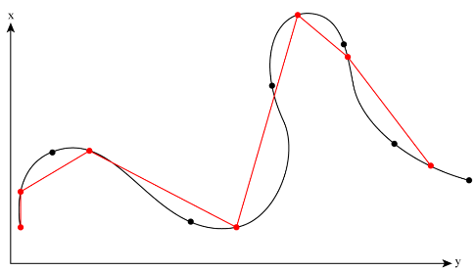
C. elegans Movement Data
Step Length Data Sets
Centroid Data Sets
(E)
Posture Data Sets

Slide 19

Towards suicide risk and stage assessment using
informal topics learnt from social media
Presenter: Mengyuan Shang
Student Member: Rae Chiang
Advisors: Dr. Daniela Stan Raicu
Dr. Jonathan Gemmell

Slide 20
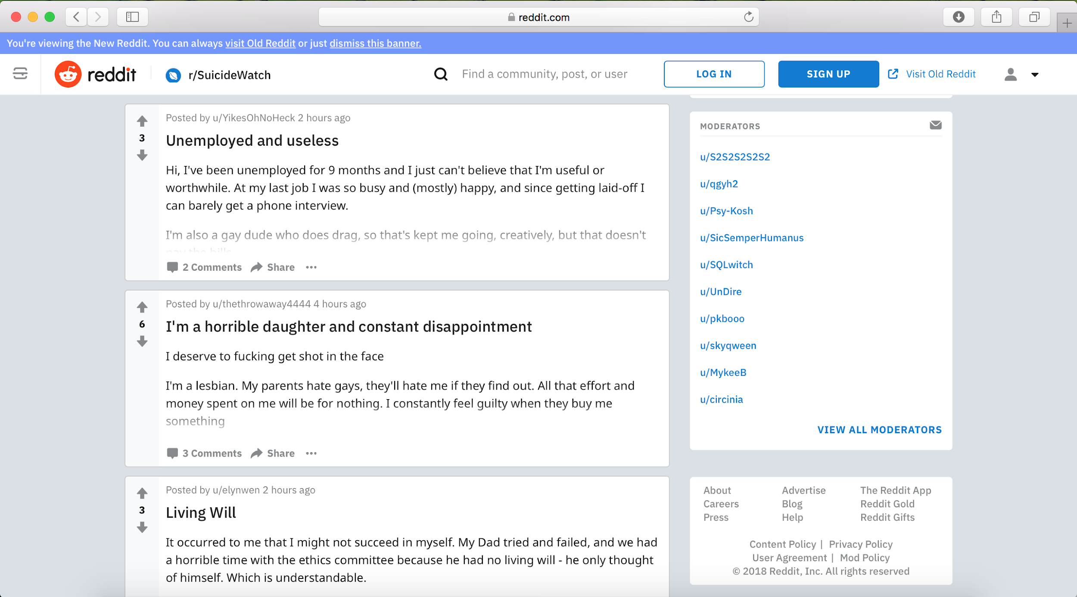
Towards suicide risk and stage assessment using
informal topics learnt from social media
Use topic model and machine learning techniques to build a model that can predict risk and stage of suicide ideation.
https://www.reddit.com/r/SuicideWatch/

Slide 21


Involve ”human in the loop” to improve predictive model performance
Improve efficiency of suicide prevention
Coaching lay people (hotline, blogs etc.)
https://www.semrush.com/blog/how-data-science-can-impact-seo-semrushchat/
https://thethoughtco.org/2017/09/09/suicide-prevention-warning-signs-helpline-details-across-india/

Slide 22

MEDIX: Medical Informatics Experience
Sam Berglin and Eura Shin

Slide 23

MEDIX: Medical Informatics Experience
Project: Representational Sampling for Active Learning in Computer Aided Diagnosis Systems
Are these nodules different?
Can we represent entire clusters with a single point?

Slide 24
Why does it matter?
Intellectual Merit: Representational and informative sampling for active learning to a problem with uncertain labels
Broader Impacts: Allows computer aided diagnosis systems to be built quicker and cheaper
Choosing your own data science project:
Eura: likes applying computer science to real world topics
Sam: liked math and computers, and data science is hot!

Slide 25


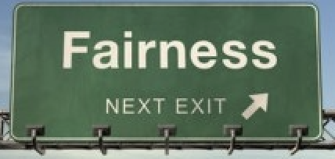
Questions?

